Slide 1
Plant Vs Zombie
Group 53:
Lê Việt Khôi – ITITIU18300
Lý Nguyễn An Khang – ITITIU17088
Nguyễn Thiên Bảo – ITITIU17035

Slide 2
Content
Plant
Zombie
Board
Game Rules
Coding

Slide 3

Plant
Peashooter: Shoot peas to damage zombie
Freeze Peashooter: Shoot freeze peas to damage and slow the zombie’s movement speed
Sun flower: Generate sun for creat plants.
Sun: Collected from Sun flower or from daylight.

Slide 4


Zombie
Normal zombie: Average speed, Low health.
Cone Head Zombie: Average speed, average health.

Slide 5
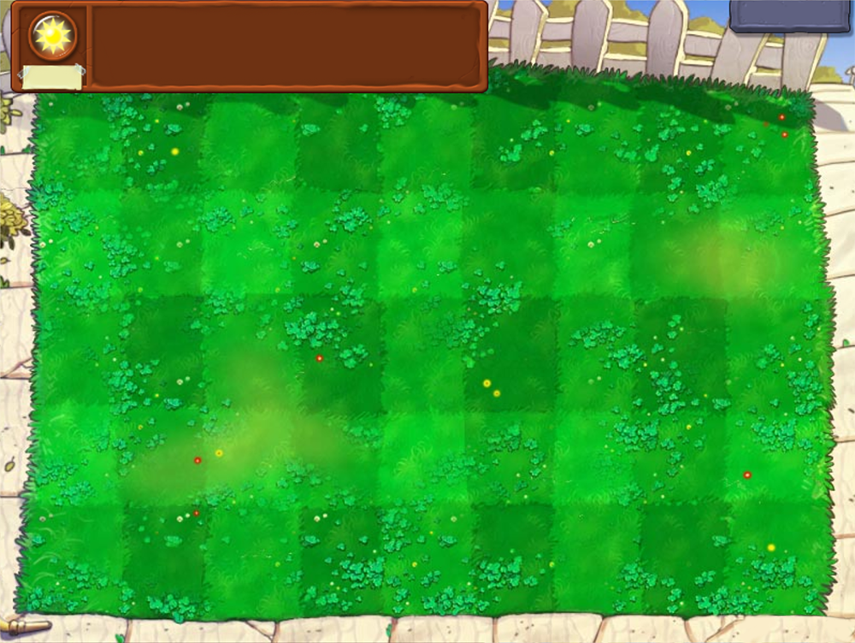

Slide 6
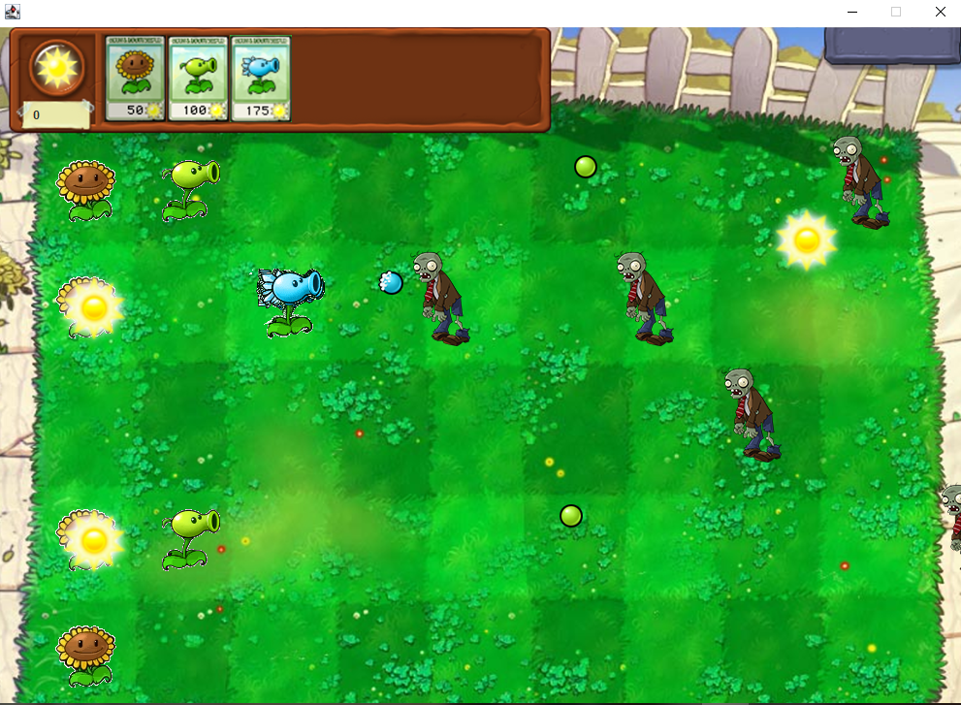

Slide 7
Game Rules
Create plant to protect your home from the huge amount of hungry zombies. You win a round by killing all the zombies. But once the zombies reach the other side of the yard, you lose.
The yard is created by 5x9 blocks and you can build only one plant on any block.
Each plant has its own power and cost, you can only create the plant when you have enough sun amount.
There are 5 lanes and the zombies are randomly spawn on them.

Slide 8
Coding
GameMain
Menu
GamePanel
Collider
Character

Slide 9
Thanks for your attention!

